Slide 1



3
2
Server1
IP: 192.168.86.23
Port: 12345
Victim Server
IP: 192.168.86.23
Port: 15555
1
Attacker sends spoofed packet with an IP equal to Victim Server
Server1 receives the spoofed packet, but sends response to Victim Server
An infinite loop of responses are created between servers
Attacker

Slide 2
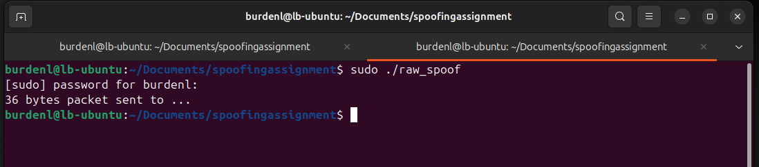
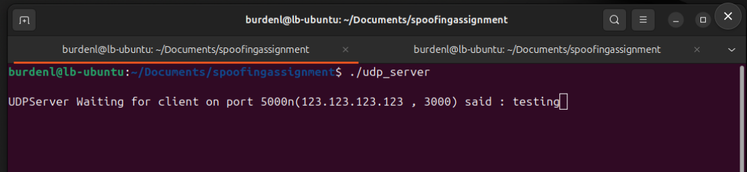
Client sending spoofed IP and port number
Server receiving spoofed IP and port number

Slide 3
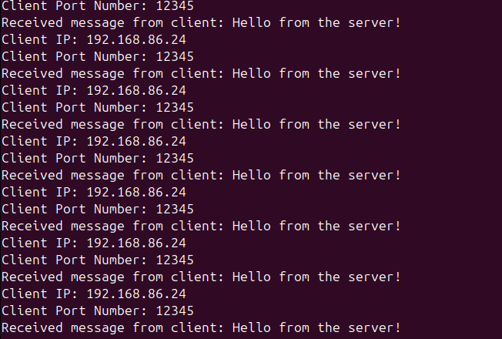
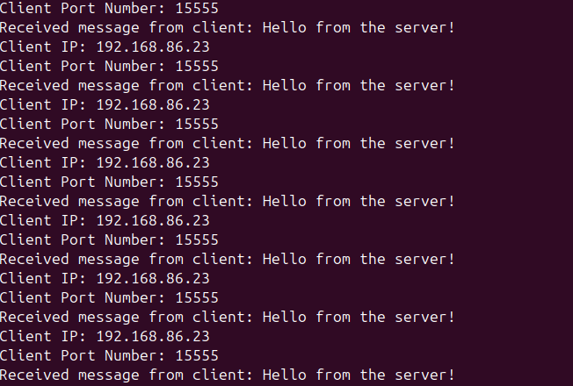
1: Client sending spoofed IP and port number
2: Server1 receives spoofed IP and responds to victim server
3: Victim server responds to server1 and causes an infinite loop

